Slide 1
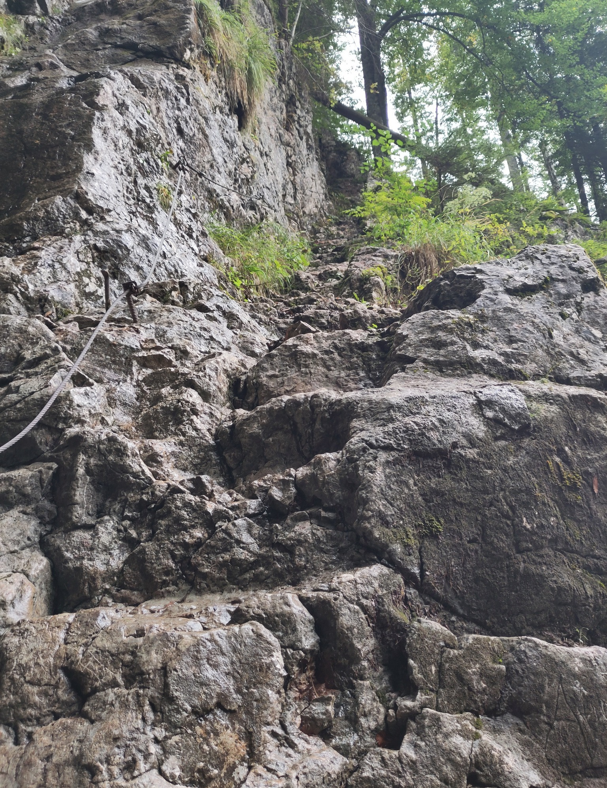
TEAMBUILDING
EXPEDITION
Management briefing for the planned alpine hiking trip
Objective: stronger team alignment,
without losing anyone on the way.
PROJECT ALPINE ALIGNMENT • PRE-TRIP REVIEW
01

Slide 2
01 / DECISION OVERVIEW
Executive summary
A high-value team event — provided we treat the mountain like a real operating environment.
1
3
1
∞
SHARED OBJECTIVE
SIGNPOSTED OPTIONS
STEEP SECTION
WEATHER VARIABLES
Business case
Operational reality
Recommendation
Create shared experiences, improve communication under pressure, and build trust outside the office.
The route includes steep, rocky terrain with a fixed cable. The photographed conditions also suggest that weather and temperature need to be treated as planning inputs.
Proceed with a clear go/no-go decision, suitable equipment, pace discipline, and a predefined turnaround / contingency plan.
TEAMBUILDING EXPEDITION • MANAGEMENT BRIEFING
02

Slide 3
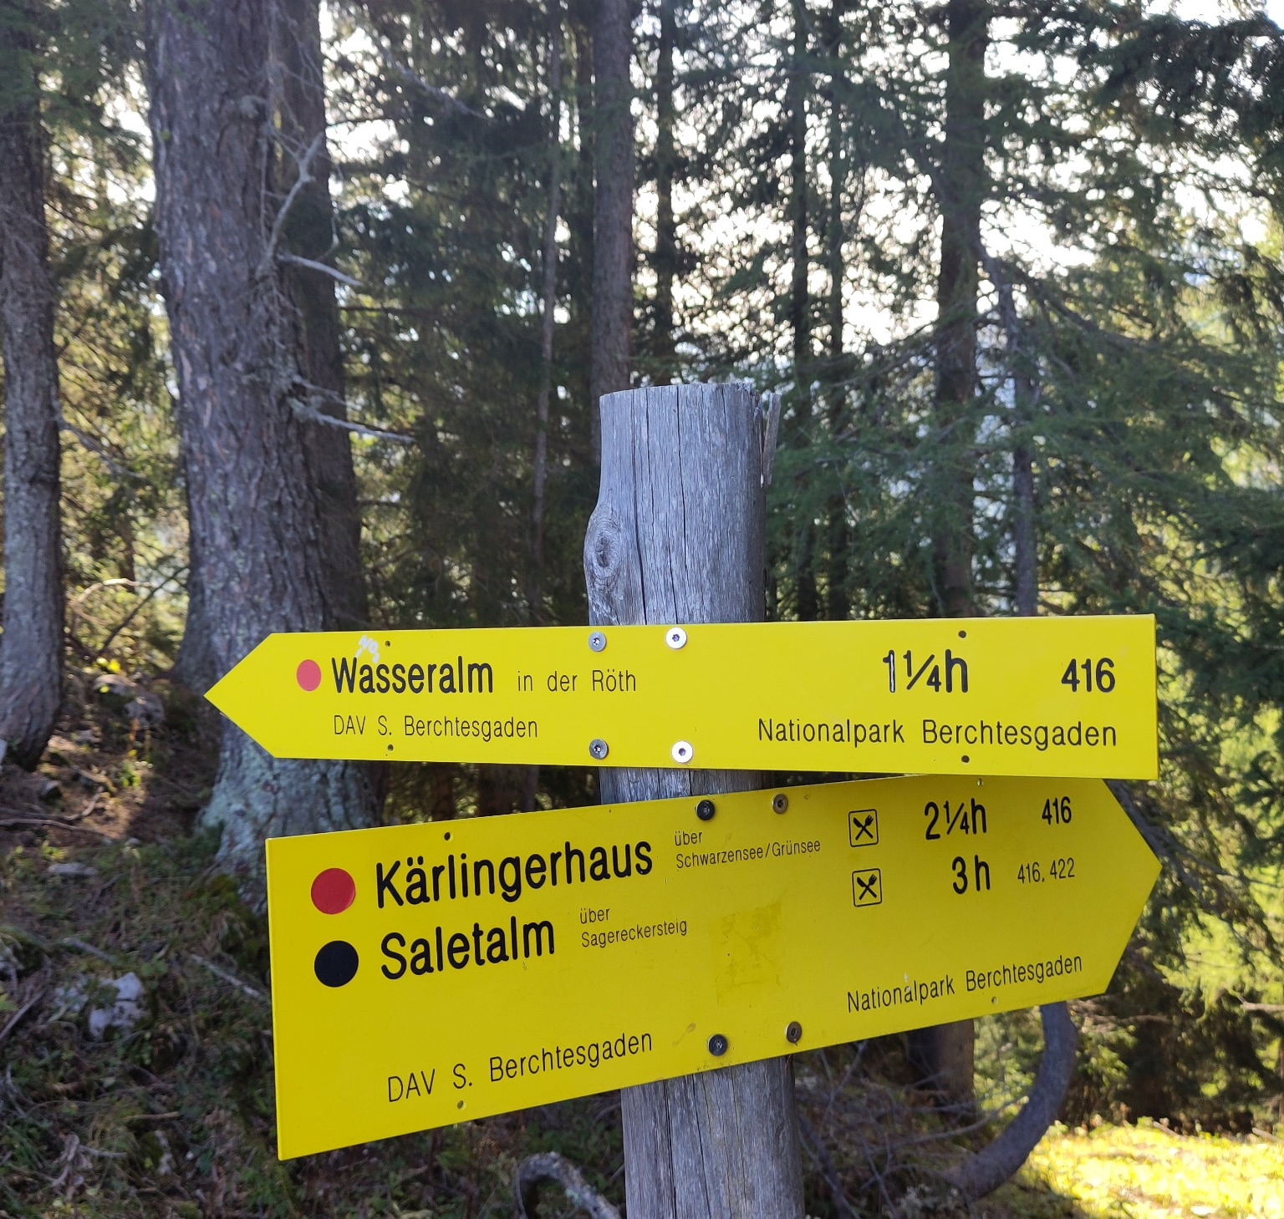
02 / ROUTE
Route options & wayfinding
The trail junction gives us three useful reference points — and a perfect excuse for a status dashboard.
SIGNPOSTED WALKING TIMES
AT THE PHOTOGRAPHED JUNCTION
Wasseralm
1¼ h
Route 416
Kärlingerhaus
2¼ h
via Schwarzensee / Grünsee • 416
Saletalm
3 h
via Sagerecksteig • 416 / 422
Key management point: the signs provide direction and indicative hiking times; they do not by themselves define the full itinerary.
TEAMBUILDING EXPEDITION • MANAGEMENT BRIEFING
03

Slide 4
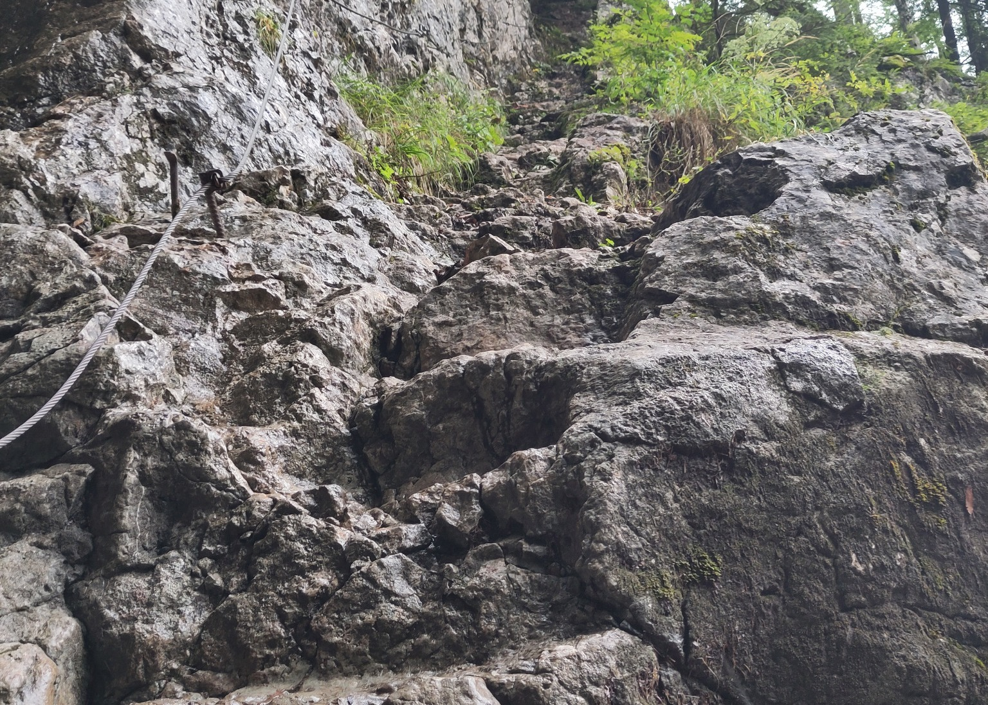
03 / TERRAIN
Terrain: where the team-building becomes real
Steep, uneven rock changes the operating model from 'walk together' to 'manage the group together'.
FIELD OBSERVATIONS
Steep ascent
High effort in short sections
Fixed cable
Useful support; requires careful use
Loose / irregular rock
Foot placement and pace matter
Wet surfaces
Traction can deteriorate quickly
Team rule: no one optimizes for speed at the expense of group cohesion.
TEAMBUILDING EXPEDITION • MANAGEMENT BRIEFING
04

Slide 5
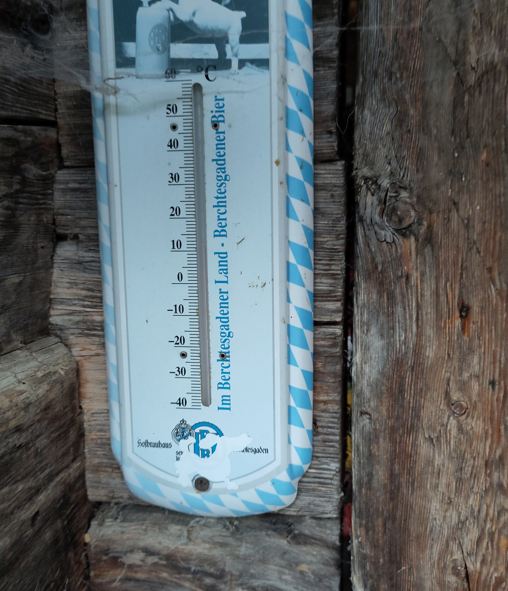
04 / CONDITIONS
Weather & temperature: the external dependencies
Cold is explicitly represented in the source material; bad weather is the broader contingency to plan for.
COLD-WEATHER RISK
Temperature is a planning constraint, not a motivational challenge.
CONTINGENCY CHECKLIST
• Forecast
Check immediately before departure
GO / NO-GO input
• Layers
Warm + waterproof options
Individual readiness
• Grip
Appropriate footwear
Traction
• Visibility
Fog / rain / low light
Navigation
• Group pace
Slowest-person principle
Cohesion
The thermometer photo is intentionally used as a visual proxy for the 'cold' scenario; no exact temperature is assumed from the image.
TEAMBUILDING EXPEDITION • MANAGEMENT BRIEFING
05

Slide 6
05 / PEOPLE
Team-building operating model
Turn the hike into a structured team exercise — without making it feel like another workshop.
01
02
03
04
Brief
Move
Pause
Reflect
Roles, route, weather, safety, buddy system
Shared pace; rotate who leads and navigates
Short regroup points: energy, hydration, direction
What helped the team move efficiently?
SUCCESS METRICS
100%
1
0
team members accounted for
shared destination / decision
avoidable heroics
TEAMBUILDING EXPEDITION • MANAGEMENT BRIEFING
06

Slide 7
06 / RISK
Risk management: corporate governance, but outdoors
A lightweight framework keeps the focus on teambuilding rather than incident management.
IMPACT →
CONTROL MEASURES
Route error
✓ Pre-trip weather check
Cold
✓ Appropriate clothing & footwear
Wet rock
✓ Buddy system / headcount
Fatigue
✓ Pace set by group, not fastest hiker
✓ Pre-agreed turnaround trigger
LIKELIHOOD →
TEAMBUILDING EXPEDITION • MANAGEMENT BRIEFING
07

Slide 8
RECOMMENDATION
Proceed — with a simple
pre-trip gate.
The photos tell a coherent story: beautiful environment, meaningful physical challenge, clear wayfinding — and a non-trivial weather dependency.
GO / NO-GO CHECK
01
Forecast acceptable
02
Everyone equipped
03
Route / turnaround agreed
04
Team is aligned on pace
SUCCESS DEFINITION
We return with stronger relationships, better stories — and the entire team.
08

